Slide 1
Active vs. Passive Strategies
Passive Strategies:
Track benchmark: Market Indices
Active strategies
Beat the benchmark
Quant Models – An example, JP Morgan Q model

Slide 2
Stock Market Indexes and ETFs
Learning objectives
Market Indices
Popular stock market Indices – How are they constructed?
Which index is the most representative of the aggregate market?
ETF
What are Exchange Traded Funds (ETFs)?
How do ETFs track various stock market Indices?

Slide 3
Stock Market Indices
Market indices are used to gauge market-wide price movements
Popular Indices
Types of indexes
Price-weighted index
Market cap-weighted index (aka. value-weighted)
Equal-weighted index

Slide 4
Stock Market Indices
Stock | Day 0 |  |  | Day 1 |  |  | Stock Return
 | Price | Shares | Cap | Price | Shares | Cap
A | 20 | 100 | 2,000 | 18 | 100 | 1,800 | -10.00%
B | 30 | 500 | 15,000 | 32 | 500 | 16,000 | 6.67%
C | 50 | 60 | 3,000 | 46 | 60 | 2,760 | -8.00%
Total Cap |  |  | 20,000 |  |  | 20,560
Price-Weighted Index – e.g. DJIA
$Day 0 Index Value=\frac{Sum of prices}{Divisor}=\frac{20+30+50}{1}=100$
$Day 1 Index Value=\frac{18+32+46}{1}=96$
divisor arbitrarily chosen
on day 0
$Index Return=\frac{96}{100}−1=−.04 or −4\%$

Slide 5

Price-Weighted Index – Stock Splits
Suppose stock A’s 2 for 1 split is effective at the end of Day 1. How will it affect the index?
If no adjustment to index computation: $Day 1 Index Value=\frac{9+32+46}{1}=87$
Q. Does the index=87 truly reflect market movement?
Choose new divisor so that $\frac{9+32+46}{d_{new}}=96⇒d_{new}=.91$
Post-split Index $=\frac{9+32+46}{.91}=96$
Stock | Day 1 |  |  | Day 1 |  |  | Stock Return
 | Price | Shares | Cap | Price | Shares | Cap
A | 18 | 100 | 1,800 | 9 18 | 200 100 | 1,800 | -10.00%
B | 32 | 500 | 16,000 | 32 | 500 | 16,000 | 6.67%
C | 46 | 60 | 2,760 | 46 | 60 | 2,760 | -8.00%
Total Cap |  |  | 20,560 |  |  | 20,560

Slide 6
Dow Jones Industrial Average (DJIA)
Price-weighted index of 30 large stocks
Divisor adjusted when (?)
What is the adjustment to the index made following regular dividends?
Implications?
DJIA divisor = 0.16268413

Slide 7
U.S. Exchange Traded Funds (ETFs)
ETFs trade on exchanges and they track selected stock indexes or bond indexes

Slide 8
DIA
ETF details
Index Tracked | Dow Jones 30
Assets Under Management | $39.41 billion
Average Daily Trading Volume | 3.25 million
Average $ Trading Volume | $1.38 billion
Expense Ratio | 0.16%
Annual Holdings Turnover | 1% - 3%
Portfolio: https://www.zacks.com/funds/etf/DIA/holding

Slide 9
ETF Portfolios
Q. Suppose you manage a fund that tracks the Dow Jones Index. How will you construct the fund portfolio?
https://www.ssga.com/us/en/intermediary/etfs/resources/education/how-etfs-are-created-and-redeemed

Slide 10

Tracking a Price-weighted index
$${Weight for stock i ≡w}_{i}=\frac{Dollar value in stock i}{Total portfolio value}$$

Slide 11
Dividends
Dow Jones does not adjust divisor for regular dividends
What are the implications?
Special dividends exceeding 10% of stock price would result in corresponding adjustment to the divisor
Q. At the end of one year will the return you earn from this portfolio exactly the same as the return on the DJIA for that year?

Slide 12
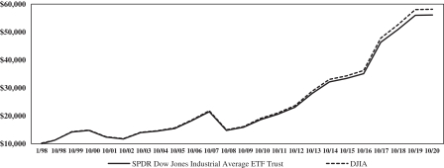
DJIA vs. DIA

Slide 13
Questions
DJIA trades at 42,638 points. DJIA divisor = 0.163
1% price increase in AAPL will increase DJIA by:
(a) 32.15 points (b) 14.85 points (c) 7.80 points (d) 5.13 points
1% price increase in UNH will increase DJIA by:
(a) 32.15 points (b) 14.85 points (c) 7.80 points (d) 5.13 points
$1 price increase in KO will increase DJIA by:
(a) 1.31 points (b) 2.40 points (c) 3.80 points (d) 6.13 points
Suppose UNH declares a stock split. Ex-split, DJIA divisor will be:
(a) bigger (b) smaller (c) the same (d) depends
Stock | Price | Market Cap $ billions
AAPL | 242 | 3,669
KO | 62 | 265
UNH | 524 | 483

Slide 14

Net Asset Value
$Net Asset Value \left(NAV\right)=\frac{Total Asset Value}{Number of Units}$
Market Price = Price at which investors trades
Should Market Price = NAV?

Slide 15
DIA Premium/Discount
Premium/Discount $≡$ Market Price/NAV - 1

Slide 16
Market Price Vs. NAV
Q. Why do the market prices closely track the NAV?
ETFs have agreements with selected brokerages to act as Authorized participants (APs) to create new ETF shares or redeem existing shares.
Creation: APs deliver underlying portfolio to the ETF sponsor and the sponsor issues to the APs the corresponding new shares
Redemption: APs deliver ETF shares the sponsor and the sponsor redeems them and delivers the underlying portfolio of individual stocks to the APs.

Slide 17
ETF Arbitrage
When actions would APs take if the ETF trades at a premium?
When actions would APs take if the ETF trades at a discount?

Slide 18
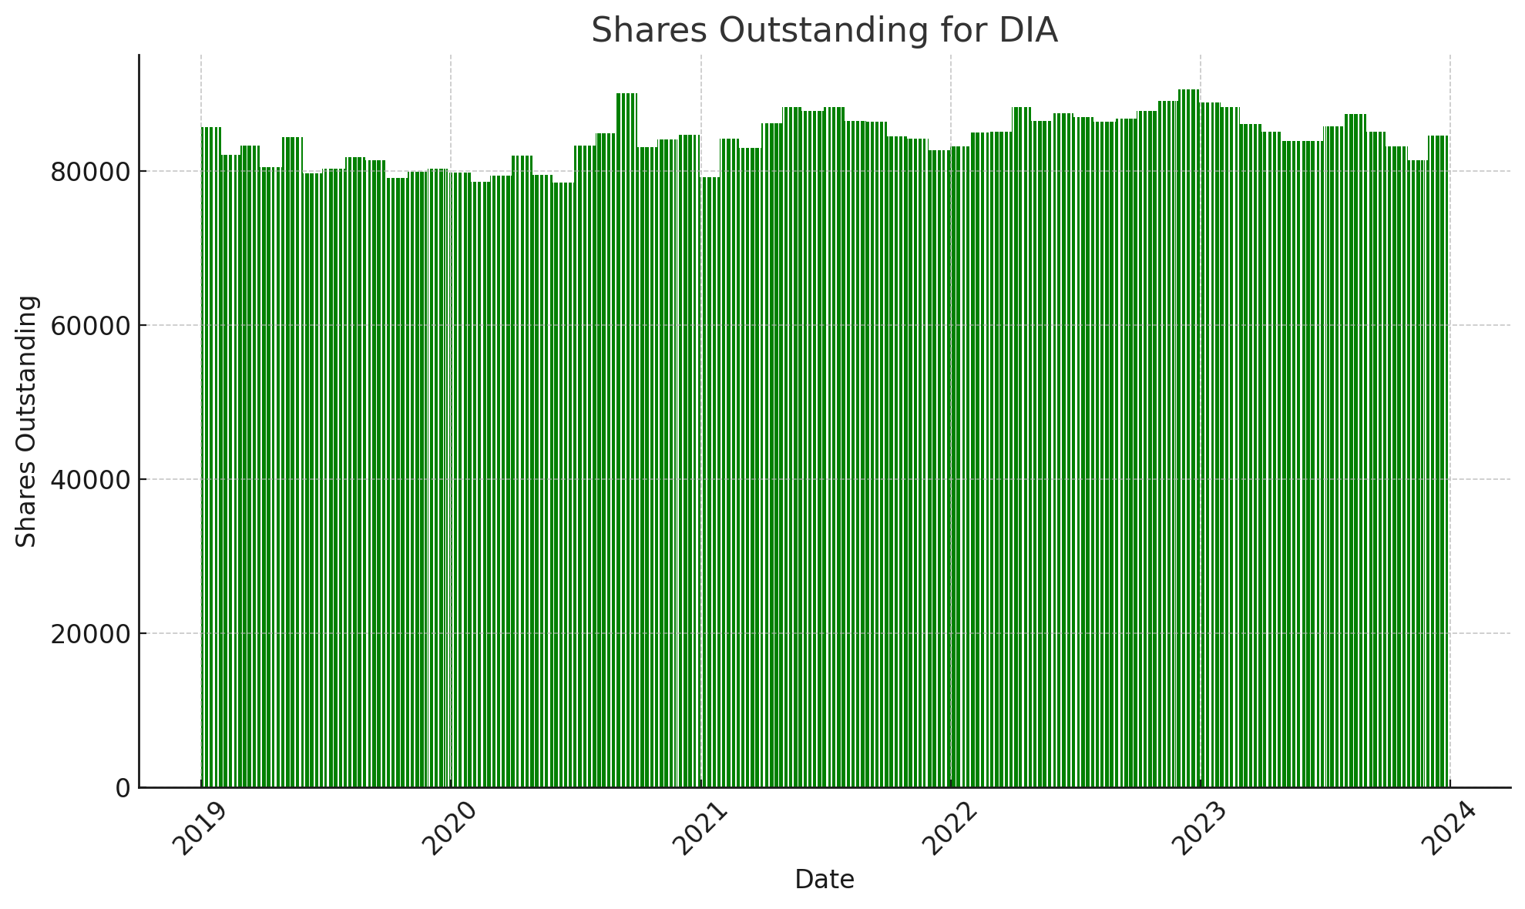
Creation
Redemption

Slide 19
Market Cap or Market Value-Weighted Index
Stock | Day 0 |  |  | Day 1 |  |  | Stock Return
 | Price | Shares | Cap | Price | Shares | Cap
A | 20 | 100 | 2,000 | 18 | 100 | 1,800 | -10.00%
B | 30 | 500 | 15,000 | 32 | 500 | 16,000 | 6.67%
C | 50 | 60 | 3,000 | 46 | 60 | 2,760 | -8.00%
Total Cap |  |  | 20,000 |  |  | 20,560
Market Cap or Value-Weighted Index – e.g. S&P500
$Day 0 Value=\frac{Total market Cap of N stocks}{Divisor}=\frac{\left(\sum_{i=1}^{N}{Price_{i}×Shares}\right)}{d}= \frac{20,000}{200}=100$
$Day 1 Index Value=\frac{20,560}{200}=$102.8
divisor arbitrarily chosen
on day 0
$Index Return=\frac{102.8}{100}−1=.028 or 2.8\%$

Slide 20
SPY
ETF details
Index Tracked | S&P 500
Total Assets | $628 billion
Average Daily Trading Volume | 45.5 million
Average $ Trading Volume | $26.7 billion
Expense Ratio | .09%
Annual Holdings Turnover | 2%-3%
Portfolio : https://www.zacks.com/funds/etf/SPY/holding

Slide 22
Market Value-Weighted Indexes
S&P 500
Index of 500 large cap stocks selected by Standard and Poor’s
Russell 1000
Index of 1000 largest stocks. Reconstituted at the end of June every year
Wilshire 5000
All publicly traded stocks
It started with about 5000 stocks but now has about 3400 stocks.
Divisor adjusted when
Stocks in the index change
Stocks declare dividend greater than 10% of price
No adjustment to the index for regular dividends
Q. Would the divisor change for stock splits?

Slide 23
Stock Market Indices
Stock | Day 0 |  |  | Day 1 |  |  | Stock Return
 | Price | Shares | Cap | Price | Shares | Cap
A | 20 | 100 | 2,000 | 18 | 100 | 1,800 | -10.00%
B | 30 | 500 | 15,000 | 32 | 500 | 16,000 | 6.67%
C | 50 | 60 | 3,000 | 46 | 60 | 2,760 | -8.00%
Total Cap |  |  | 20,000 |  |  | 20,560
Q. VW is an ETF that tracks a market value-weighted index with the three stocks. Its AUM is $100. Construct VW’s tracking portfolio.

Slide 24
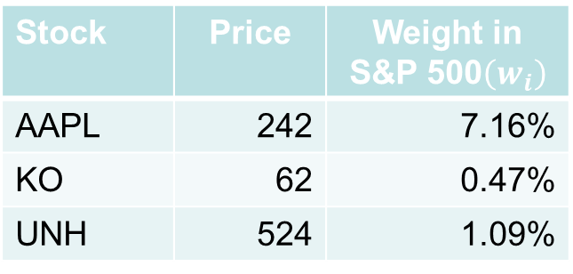
Questions
S&P 500 trades at 5,918 points.
1% price increase in AAPL will increase S&P 500 by:
(a) 4.24 points (b) 0.28 points (c) 3.22 points (d) 0.65 points
1% price increase in KO will increase S&P 500 by:
(a) 4.24 points (b) 0.28 points (c) 3.22 points (d) 0.65 points
Suppose UNH declares a stock split. Ex-split, S&P 500 divisor will be:
(a) bigger (b) smaller (c) the same (d) depends
Stock | Price | Weight in S&P 500$\left(w_{i}\right)$
AAPL | 242 | 7.16%
KO | 62 | 0.47%
UNH | 524 | 1.09%

Slide 25
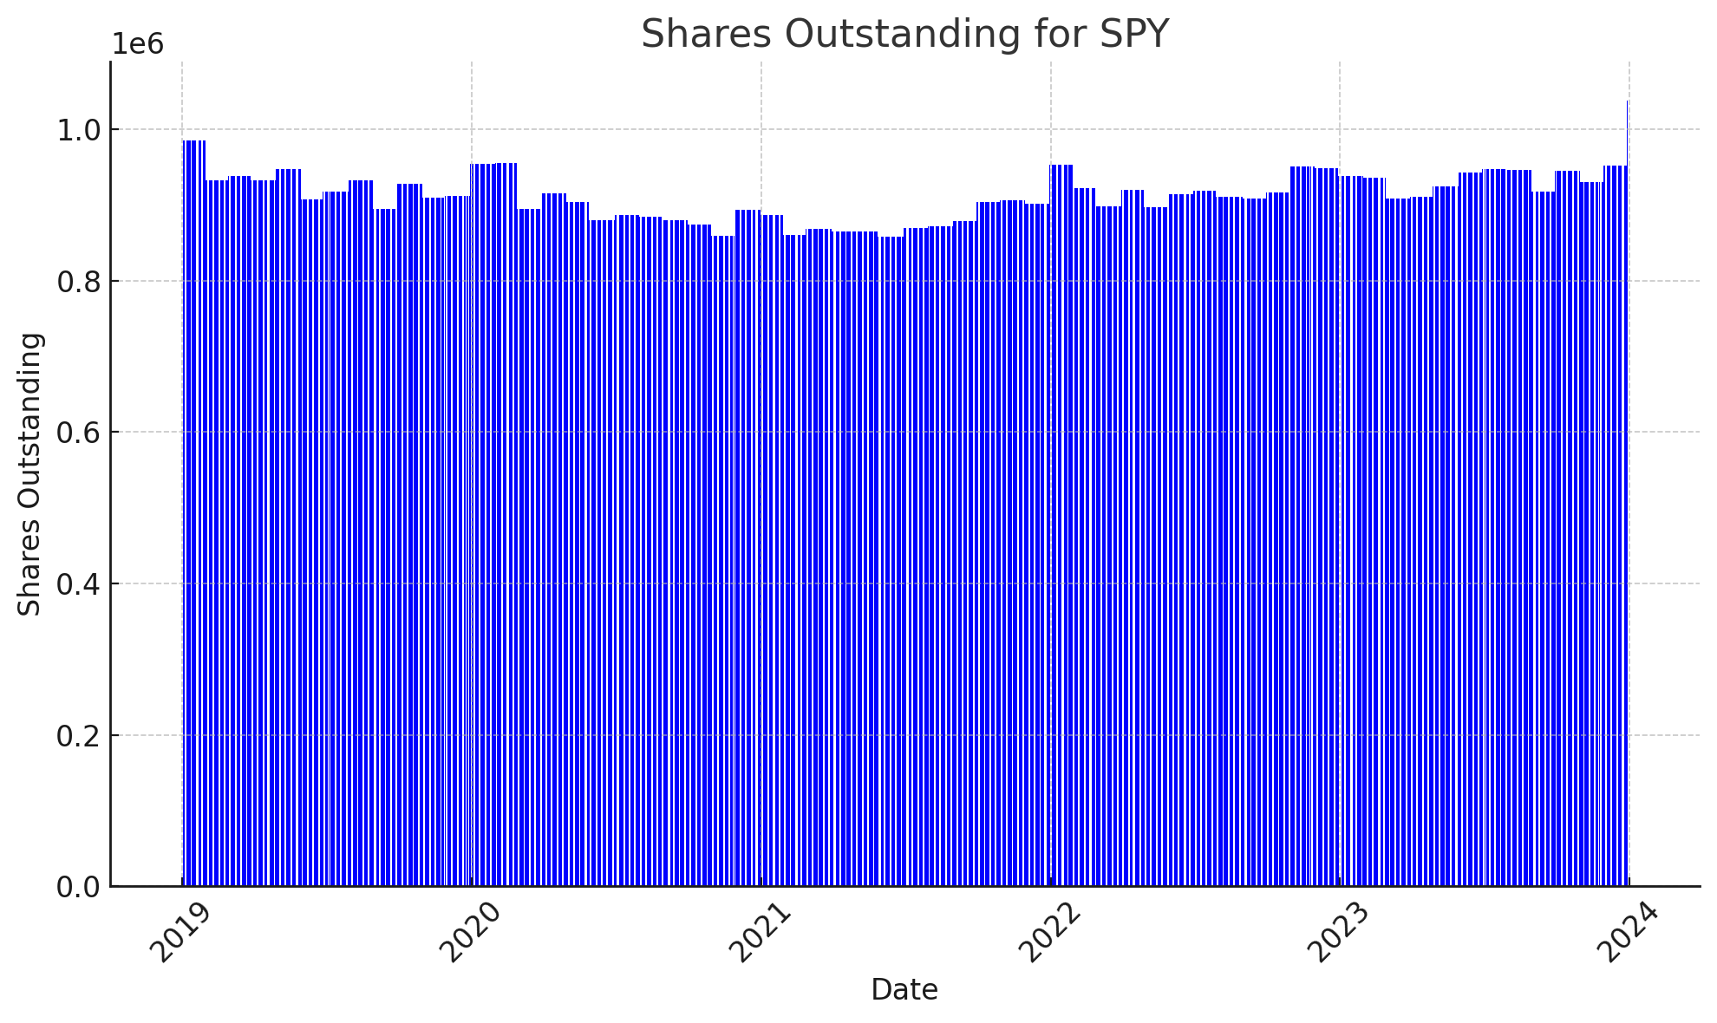
Creation
Redemption

Slide 26


Equal-Weighted Index
Stock | Day 0 |  |  | Day 1 |  |  | Stock Return
 | Price | Value | #shares | Price | #shares | Value
A | 20 | 100 | 5.0 | 18 | 5.0 | 90.00 | -10.00%
B | 30 | 100 | 3.33 | 32 | 3.33 | 106.67 | 6.67%
C | 50 | 100 | 2.00 | 46 | 2.00 | 92.00 | -8.00%
Total Portfolio value |  |  | 300 |  |  | 288.67
$$EWI Return =\frac{288.67}{300}−1=−3.78\%$$
$$EWI Return =\frac{−10+6.67−8}{3}=−3.78\%$$
RSP factsheet

Slide 27
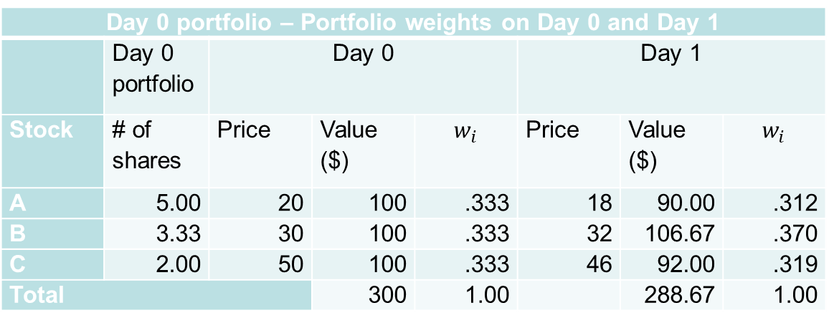
Tracking an Equal-weighted Index
Day 0 portfolio – Portfolio weights on Day 0 and Day 1
 | Day 0 portfolio | Day 0 |  |  | Day 1
Stock | # of shares | Price | Value ($) | $$w_{i}$$ | Price | Value ($) | $$w_{i}$$
A | 5.00 | 20 | 100 | .333 | 18 | 90.00 | .312
B | 3.33 | 30 | 100 | .333 | 32 | 106.67 | .370
C | 2.00 | 50 | 100 | .333 | 46 | 92.00 | .319
Total |  |  | 300 | 1.00 |  | 288.67 | 1.00

Slide 28
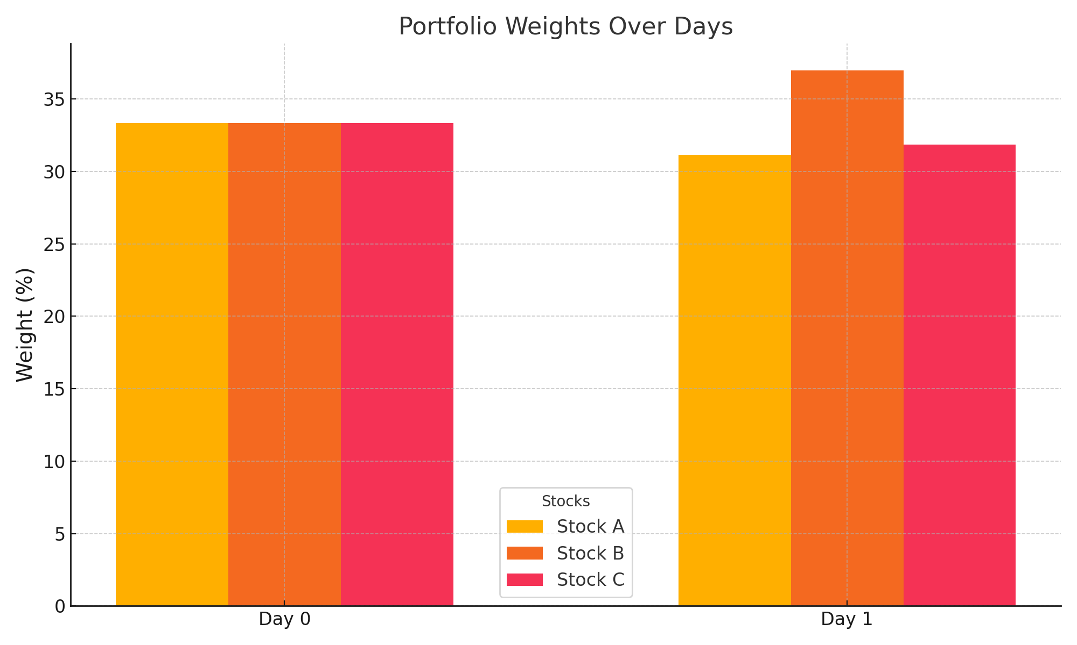
Portfolio Weights: Day 0 Vs. Day 1
Q. Would the Day 0 portfolio track the index after Day 1?

Slide 29
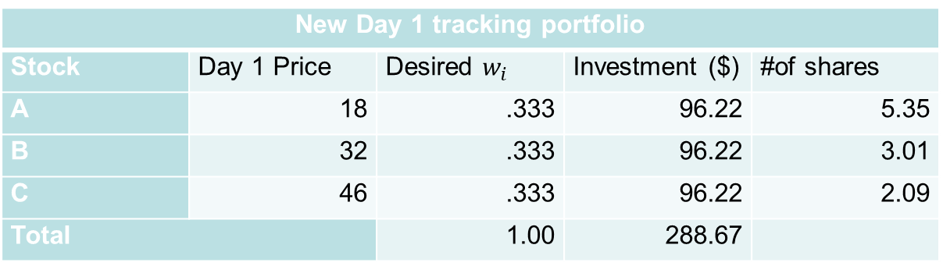
Rebalancing
New Day 1 tracking portfolio
Stock | Day 1 Price | Desired $w_{i}$ | Investment ($) | #of shares
A | 18 | .333 | 96.22 | 5.35
B | 32 | .333 | 96.22 | 3.01
C | 46 | .333 | 96.22 | 2.09
Total |  | 1.00 | 288.67

Slide 30
RSP
ETF details
Index Tracked | S&P Equal Weighted Index
Assets Under Management | $73.6 billion
Average Daily Trading Volume | 5.7 million
Average $ Trading Volume | $1 billion
Expense Ratio | .20%
Annual Holdings Turnover | 20% - 25%
The S&P 500® Equal Weight Index (EWI) includes the same constituents as the capitalization weighted S&P 500,
but each company is allocated a fixed weight - or 0.2% of the index total at each quarterly rebalance.
Why RSP?
https://www.zacks.com/funds/etf/RSP/holding

Slide 31
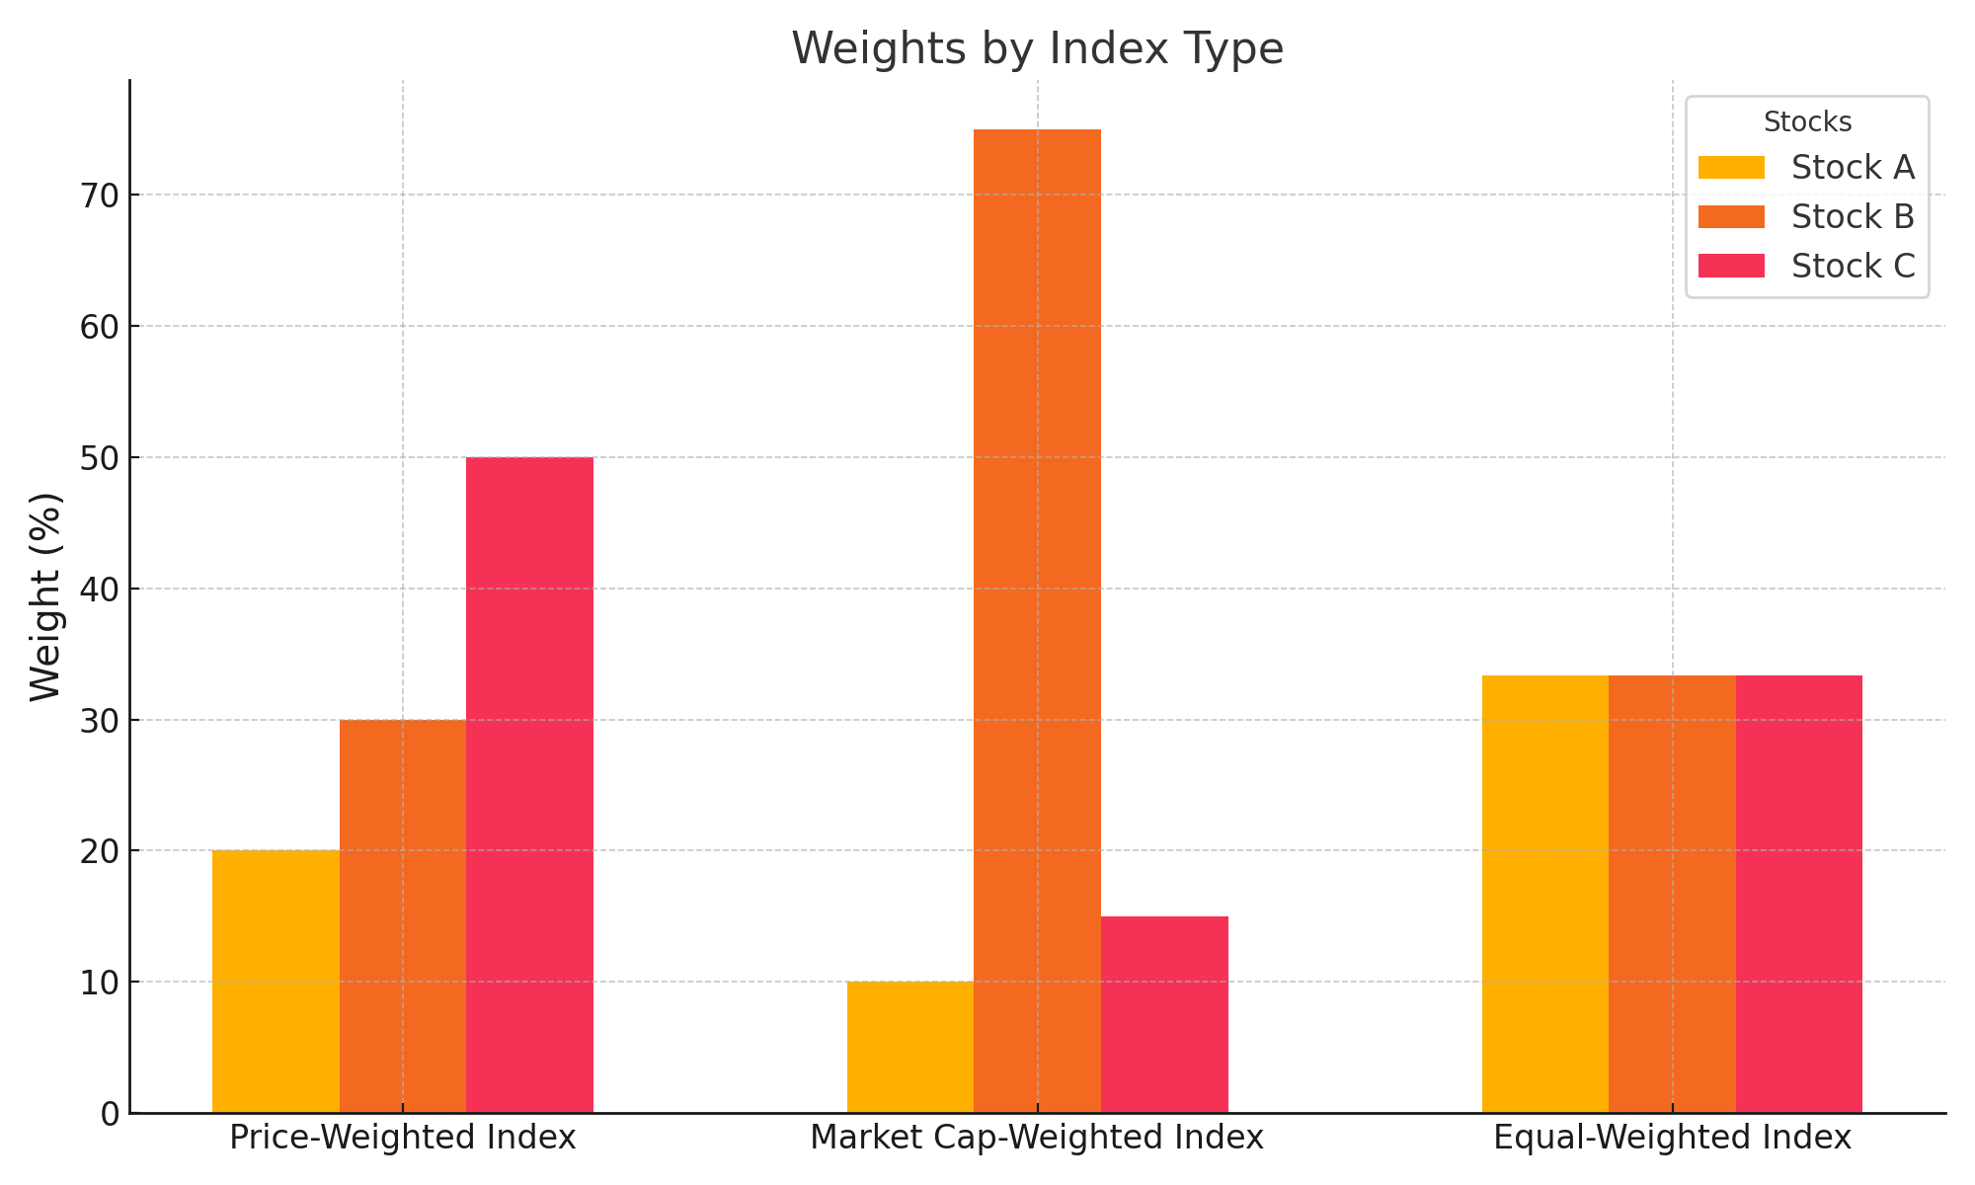
Portfolio Weights by Index Types
Q. Which index would have the best performance on days
when small stocks outperform large stocks?

Slide 32
Active strategies
Beat the Market:
Fundamental Analysis: Forecast cash flows and compute intrinsic values
Quant Models: Identify stocks expected to outperform or underperform the market.
“Quantamental” : Hybrid of Fundamental and Quant

Slide 33
Quant Models
Identify stock features that reliably predict returns
Build a quant model with multiple features
Back test performance
Example: JP Morgan’s Q model

Slide 34
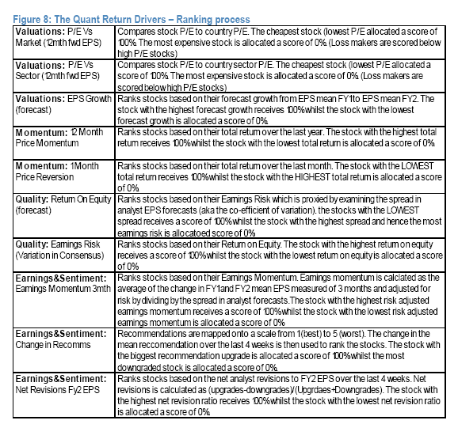

Slide 35
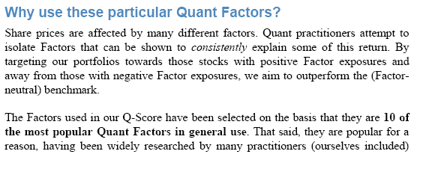
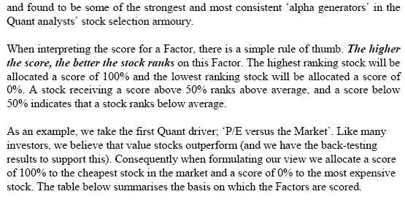

Slide 36
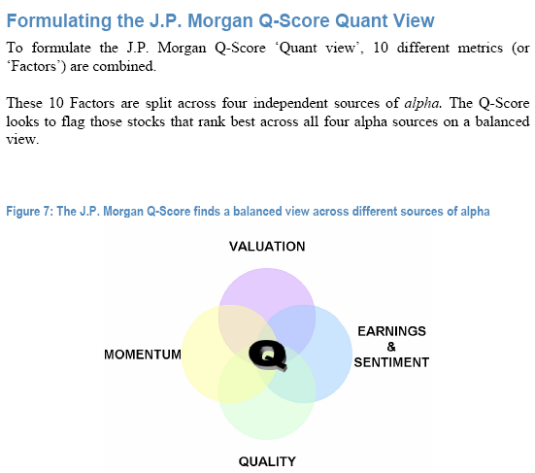
Quant Models: Combining Factors

Slide 37
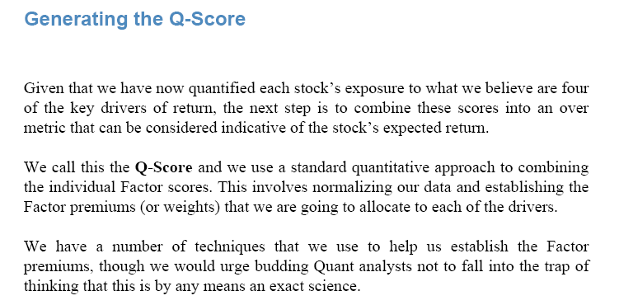

Slide 38
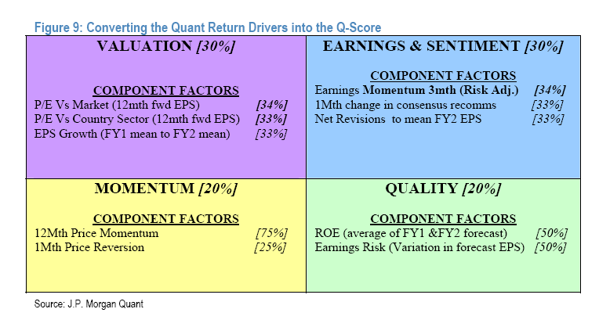

Slide 41
Quant Models
Identify stock features
Academic and practitioner studies
Individual research
Build a model with multiple features
Assign scores based on individual features and aggregate them (e.g. JPM Q-model)
Regression models
Regression trees
Random Forest
XGBoost
LLMs

